Slide 1

Agent Activity Chart
5/29/2023 11:21 PM
Print User : selenium.automation
Page 1 of 3

Slide 2
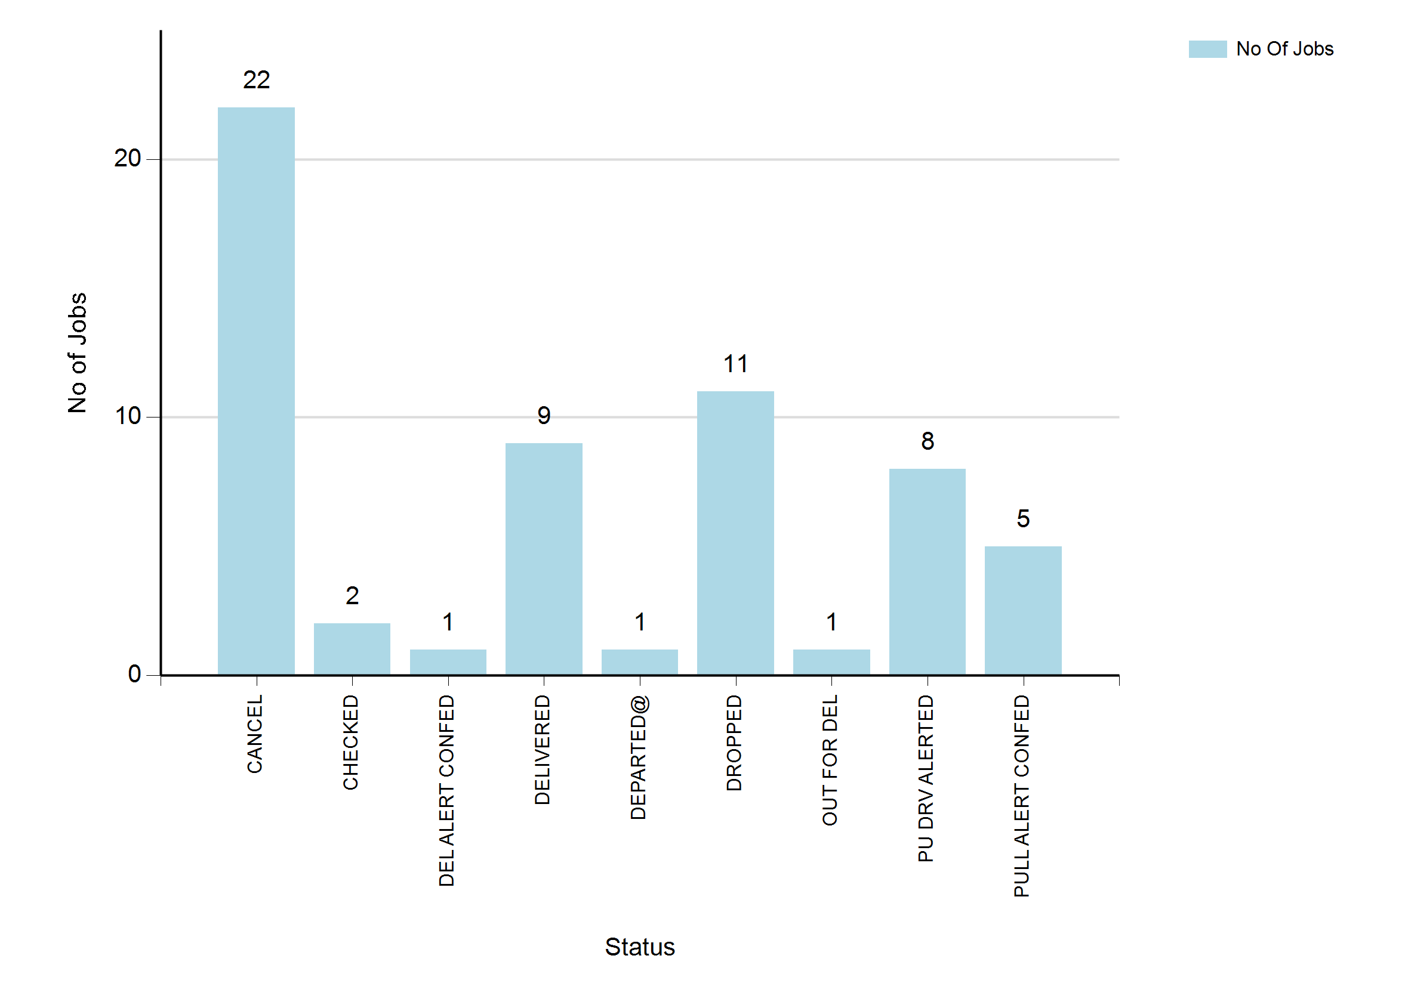
5/29/2023 11:21 PM
Print User : selenium.automation
Page 2 of 3

Slide 3
5/29/2023 11:21 PM
Print User : selenium.automation
Page 3 of 3

